Slide 1
CET440: Computer Networking
Lab
Dr. Weifeng Chen
Notes:
IP: 158.83.254.100
Draco1.calu.lcl
Login to Putty with
Pennwest email
Pennwest Password
To download file:
wget https://students.calu.edu/calupa/chen/cet440/lab/summation.c
To compile file:
gcc summation.c –o summation
To run file:
./summation
Common commands:
pwd
ls
mkdir foldername - To create file
wget - to get the file
<right click moust> - copys text to command
rm filename.ext - remove file
Write out is to save
^X means Ctrl + X

Slide 2
Objective
Lab exercises/assignments
  Obtain Unix Competency
  Transfer knowledge of C programming to the Unix environment and to gain experience in using system library routines.
    Modulization
    Inter-Process-Communication (IPC)
    Client/Server architecture
    Security
Notes:
SOLO
Modulization
TEAM
Inter-process-comm (IPC)
Client/Server Arch
Security (Basic Security)

Slide 3
Components
Individual programming assignments
  First three weeks
Team-based project (3 persons per team)
  Phase I : IPC (Master/Slave) – 3 weeks
  Phase II: Socket programming (Server/Client) – 4 weeks
  Phase III: Security (authentication, encryption/decryption) – 4 weeks
Notes:
Master -> Server
Slave -> Client
Phase II: Socket API

Slide 4
Login to Draco1
Install virtual desktop infrastructure (VDI)
  https://itservices.pennwest.edu/instructions/virtual-desktop-access
Download putty.exe (Google it)
  See next slide

Slide 5
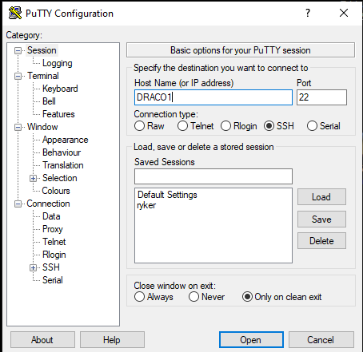
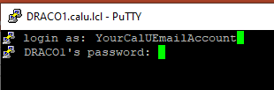

Slide 6
Login to DRACO1 off campus
Virtual Desktop Infrastructure (VDI)
https://itservices.pennwest.edu/instructions/virtual-desktop-access
Access VDI using your PennWest account, using the “Student Math and Comp”
Then use putty to log in to DRACO

Slide 7

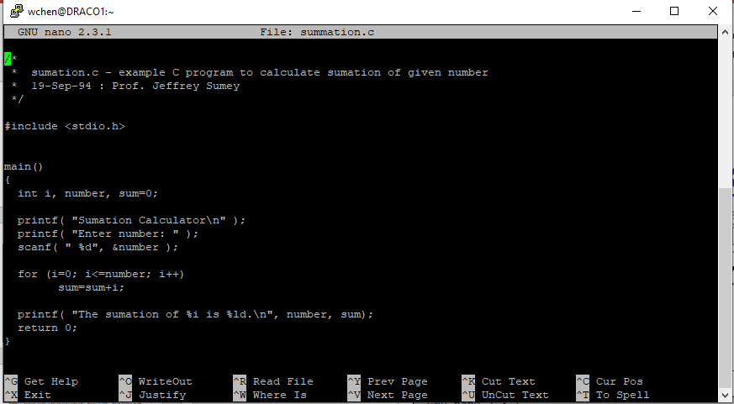
Edit source file on DRACO1
nano editor
nano commands: e.g., ^X means Ctrl+X

Slide 8
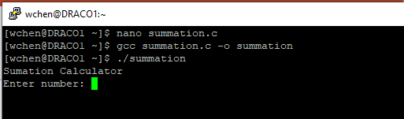
Compile and execute
gcc source.c –o executable

Slide 9
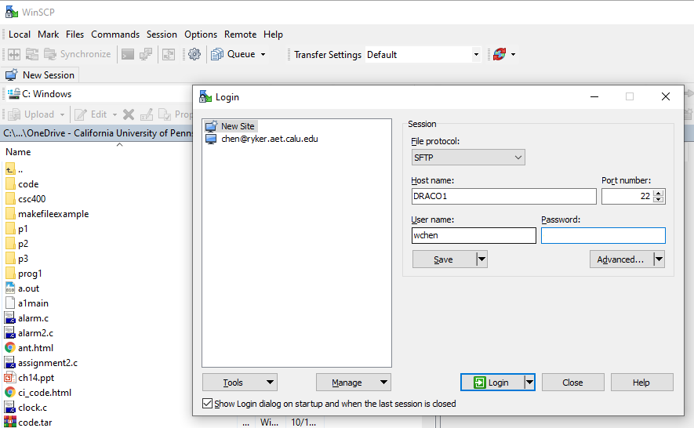
Edit in Windows and transfer to DRACO1 (on-campus or VDI)
winSCP

Slide 10
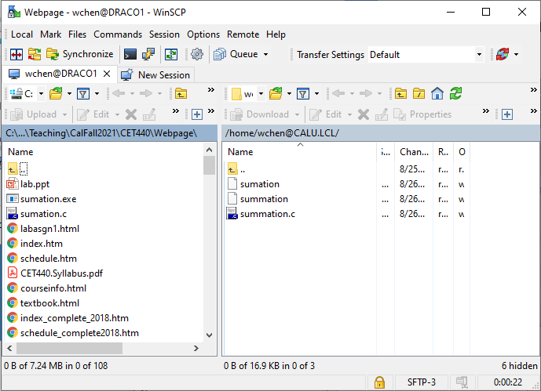
Edit in Windows and transfer to DRACO1
winSCP
Local
DRACO1
Drag and Release to transfer files between them

Slide 11
Today’s lab assignment
https://students.calu.edu/calupa/chen/cet440/lab/labasgn1.html

